Slide 1
Docker & Selenium Project
Yogesh Nivrtti Patil
Employee ID: 201316
AQE

Slide 2
CONTENTS
Introduction
1
Introduction
2
Selenium Project
3
Docker Project
4
Code Snippet & Outputs

Slide 3
Introduction to Selenium & Docker
Selenium
Open Source Automation Testing Framework
Supports Multiple Operating Systems
Supports Muliple Programming Language
Popular Language used is Java and C#.
Docker
Docker is an open-source platform for containerization.
Containers are lightweight, isolated environments that ensure consistency in software deployment.
Containers run consistently across different environments, from development to production.
Docker ensures that applications behave the same way in any environment, reducing "it works on my machine" issues.

Slide 4
Project 1
Selenium
Automating Website using Selenium

Slide 5
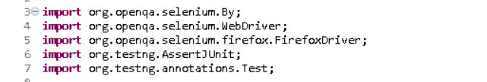
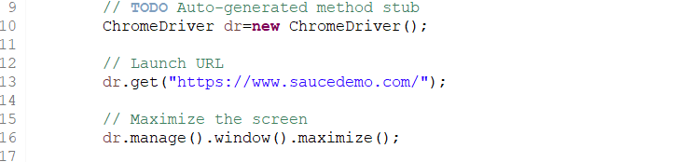
Import and Creating Object of Webdriver
Step 1: Importing Necessary imports
Step 2: Creating Object of Webdriver and launching URL

Slide 6
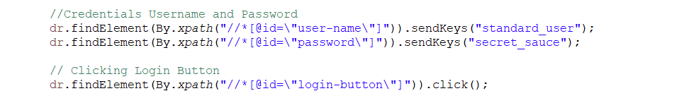
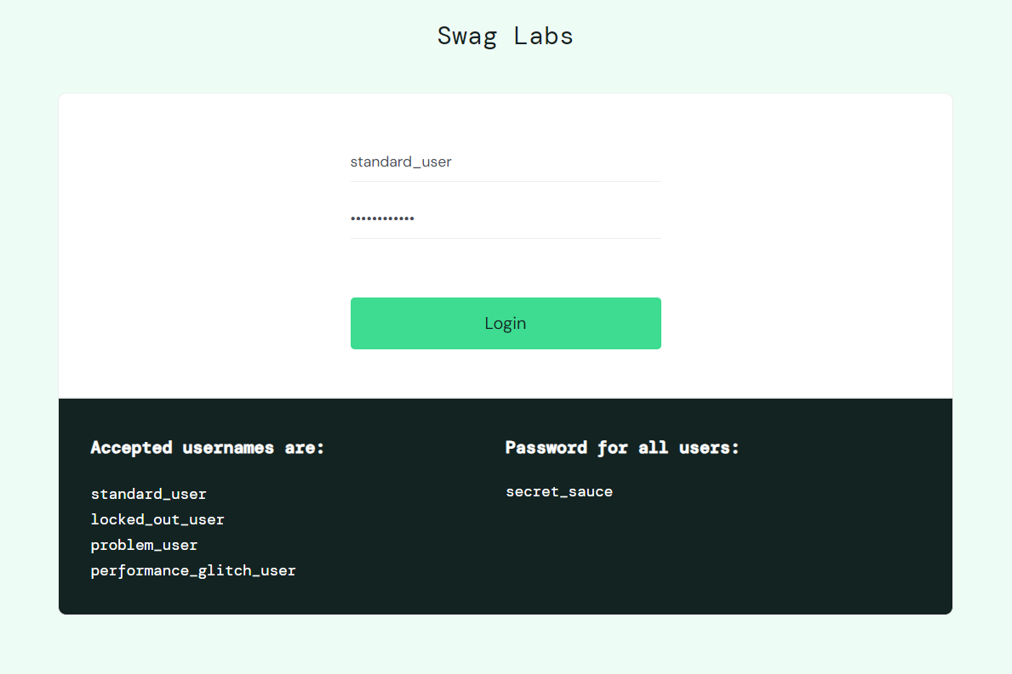
Login Module
Step 3: Logging in with credentials

Slide 7
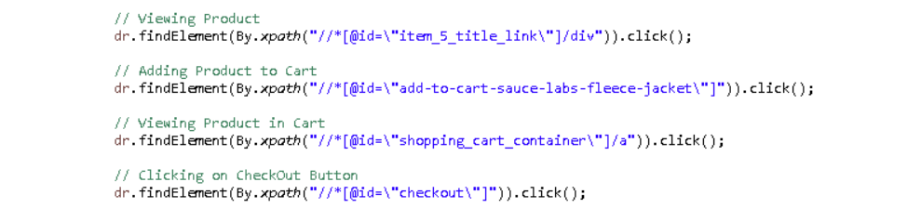
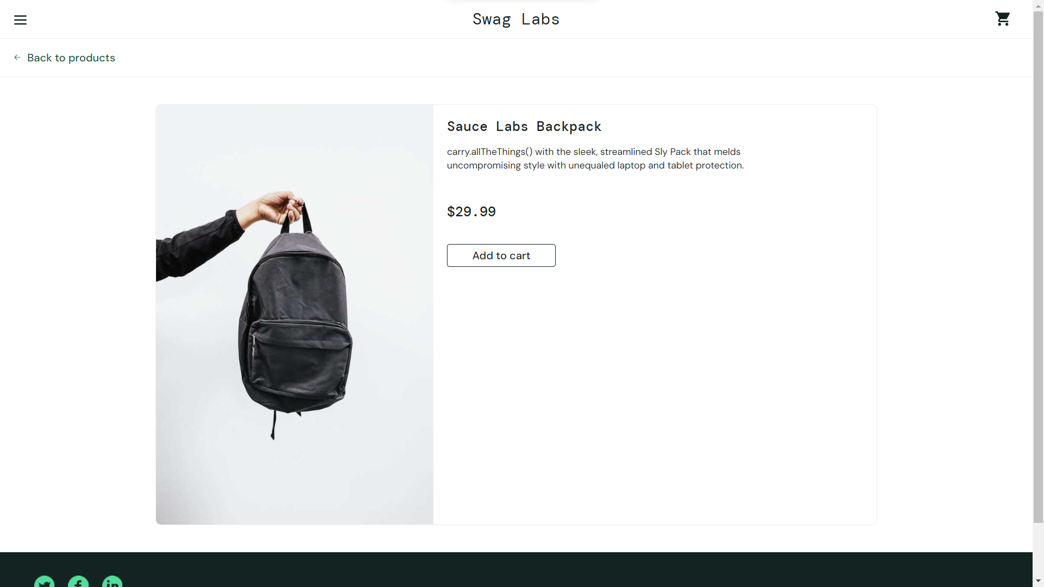
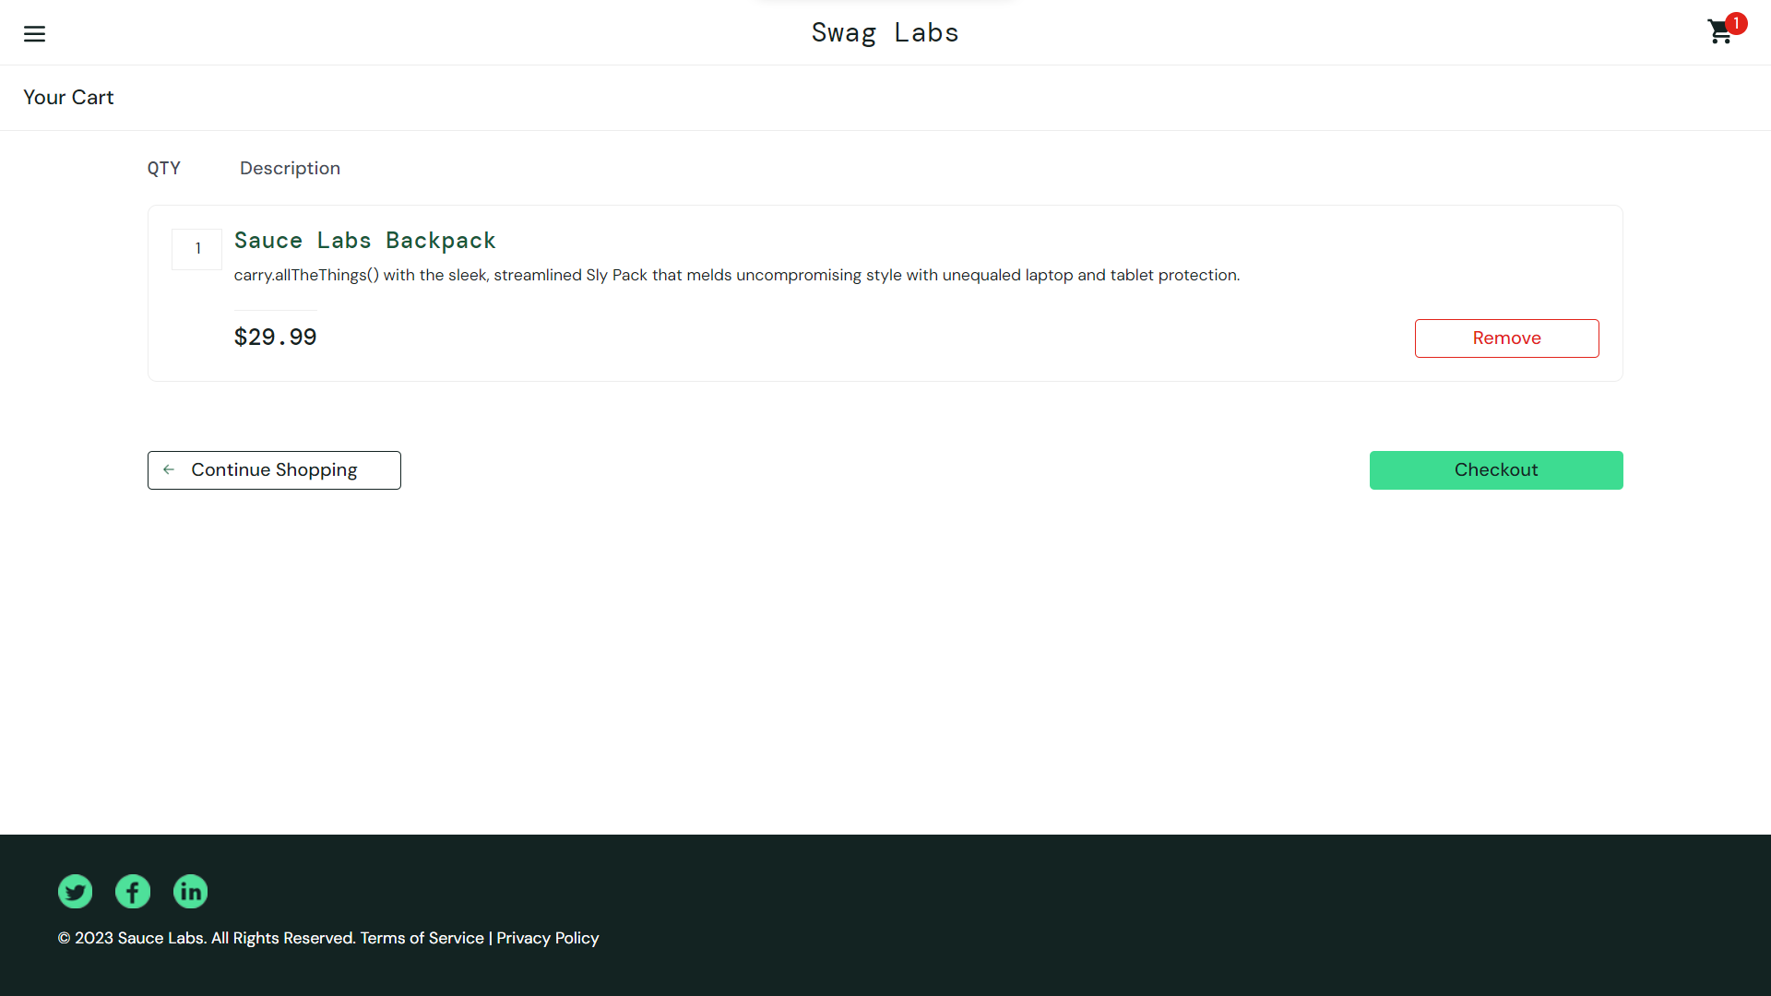
Viewing Product and Adding Product to Cart

Slide 8
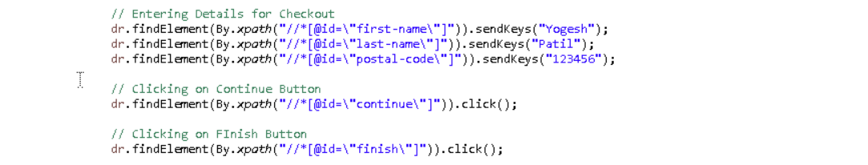
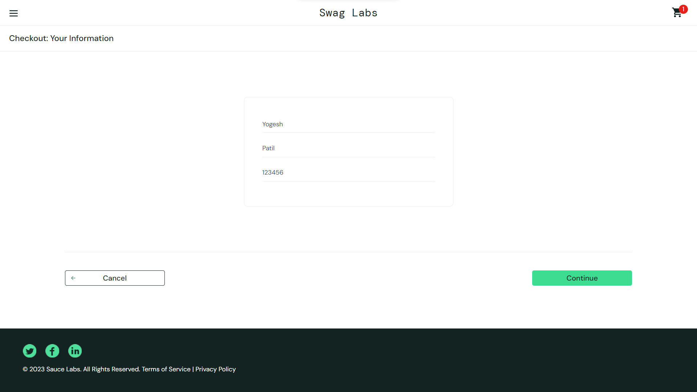
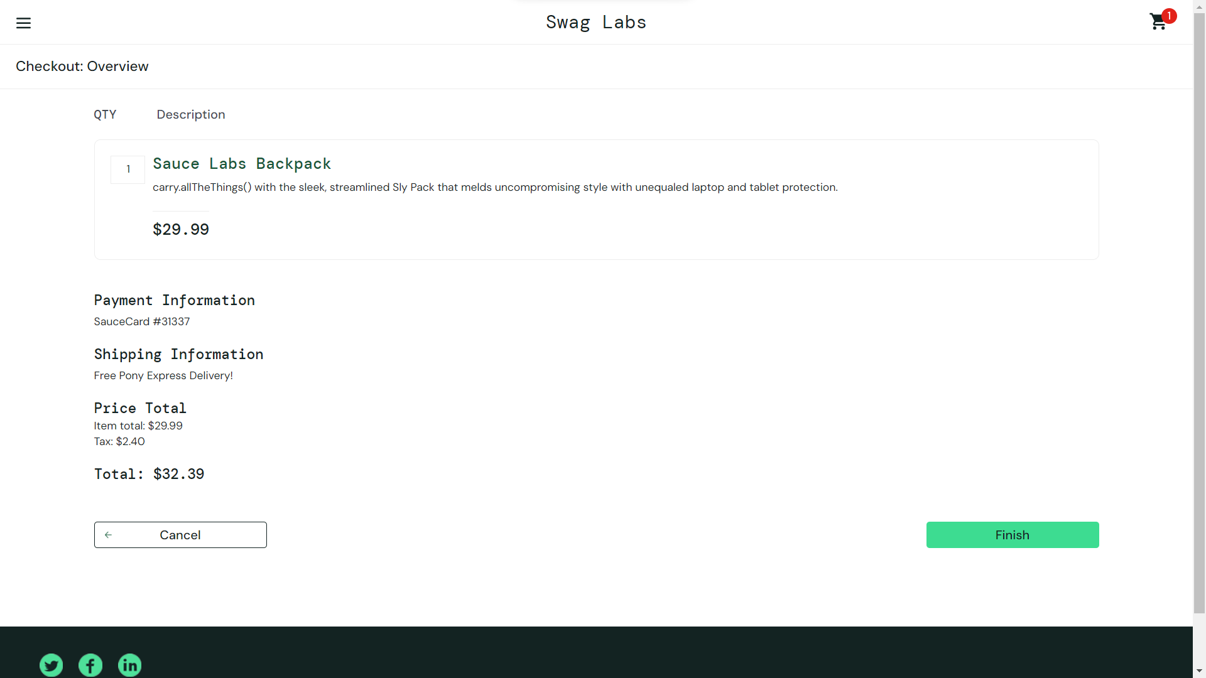
Entering Checkout Details and Confirmation of Order

Slide 9
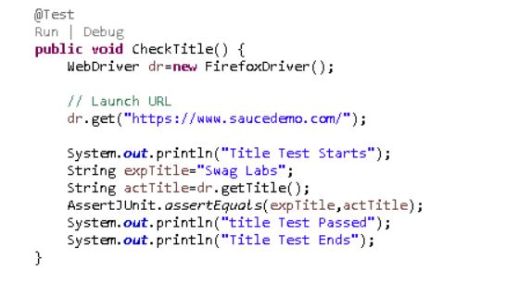
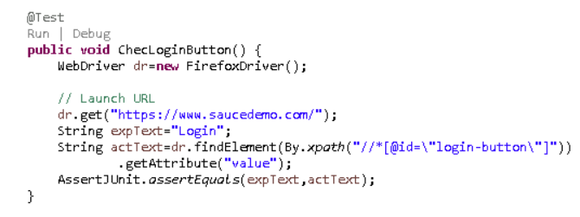
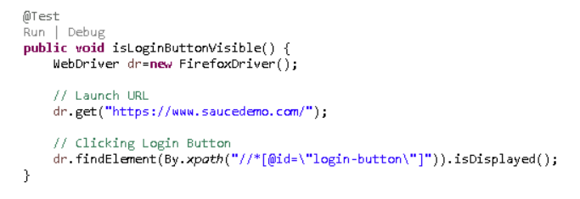
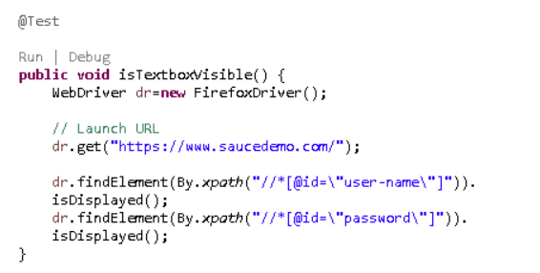
Test Cases Using TestNG

Slide 10
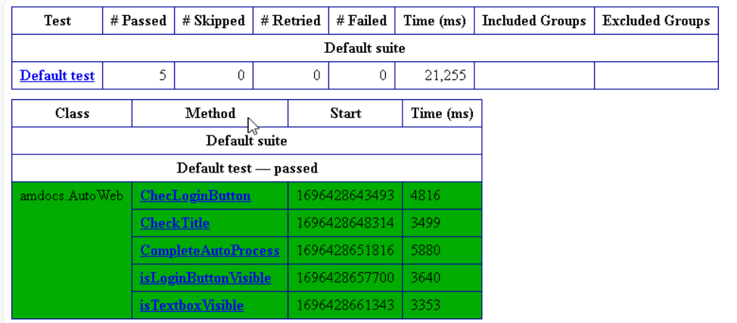
Generating Test Report

Slide 11
Project 2
Docker
Automating Website using Selenium

Slide 12
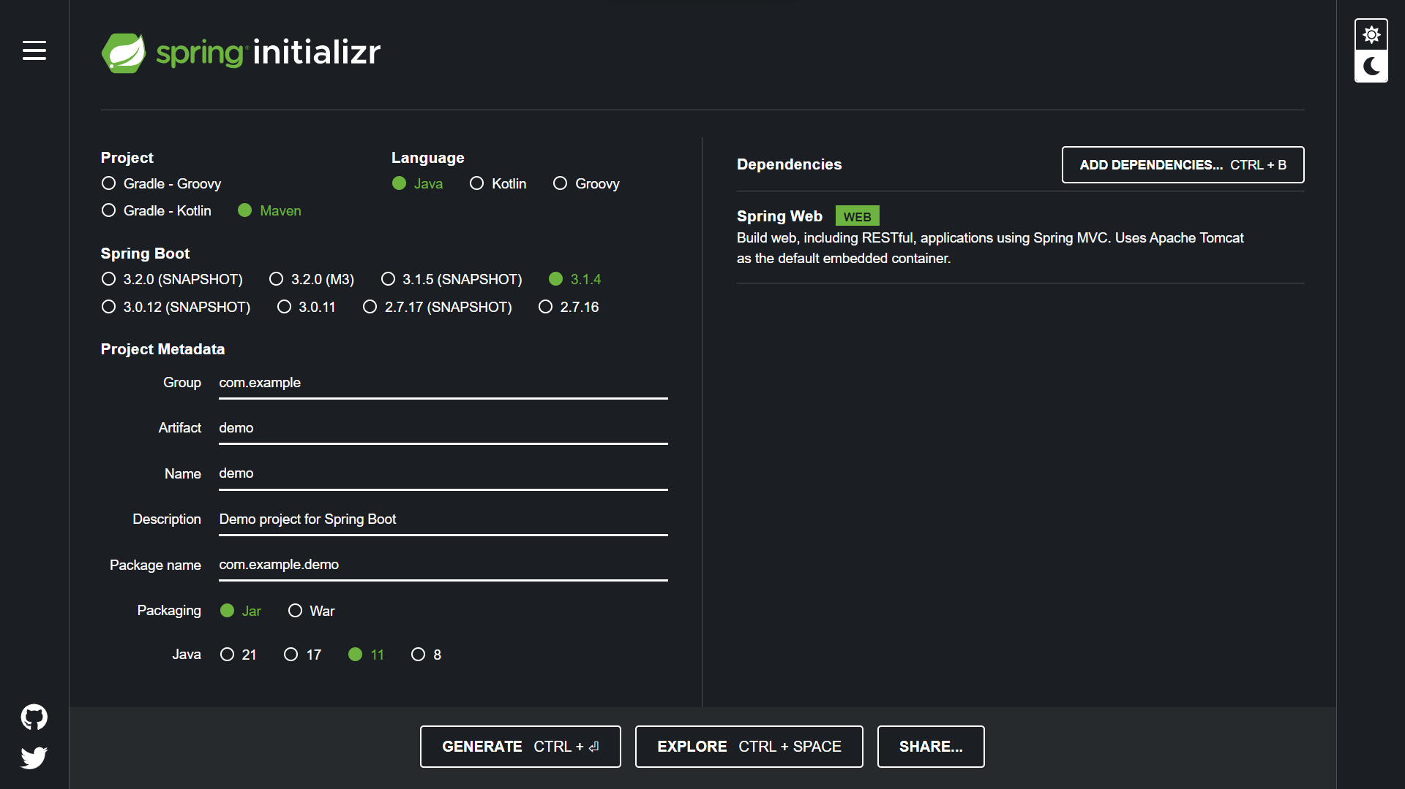
Creating Spring Boot Project
Step 1: Create a Spring Boot Project with following requirements

Slide 13
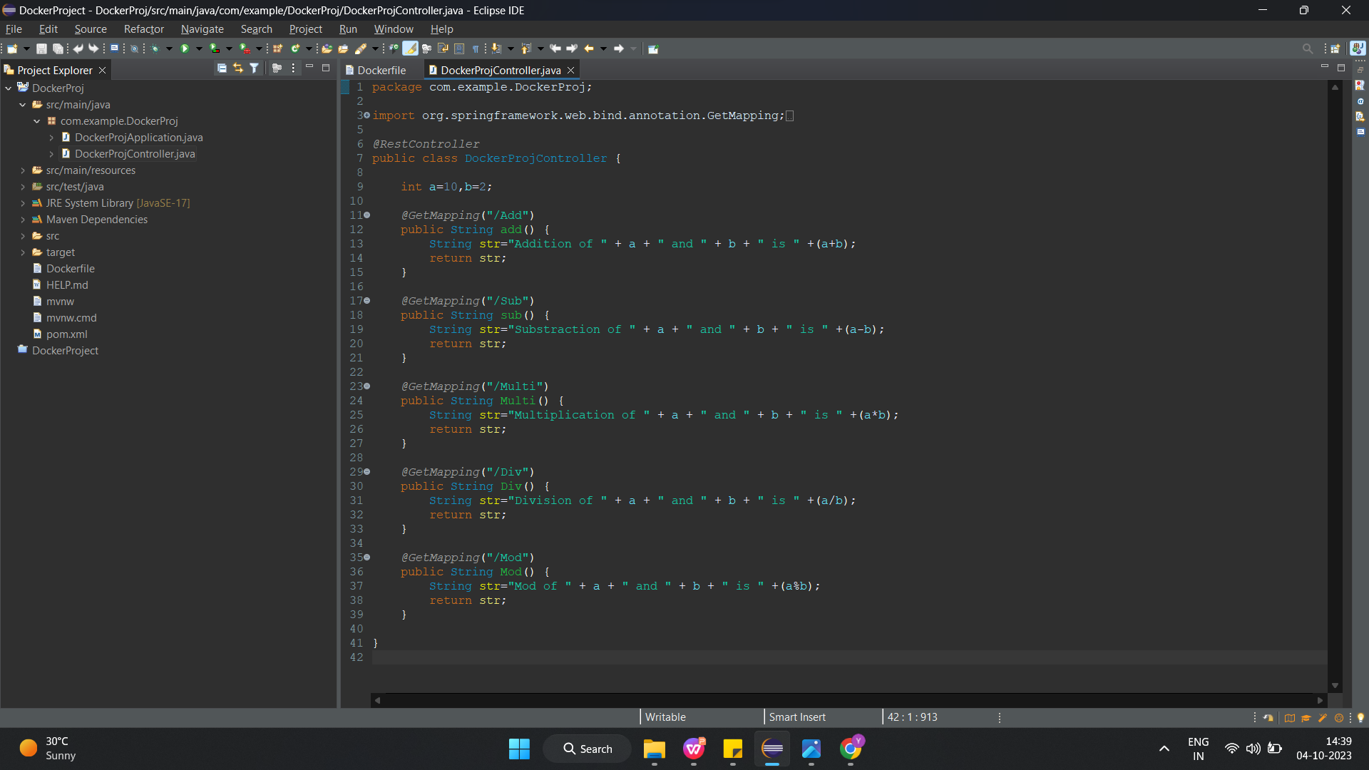
Creating Java Class for Actucal code
Step 2: Create a Java Class

Slide 14

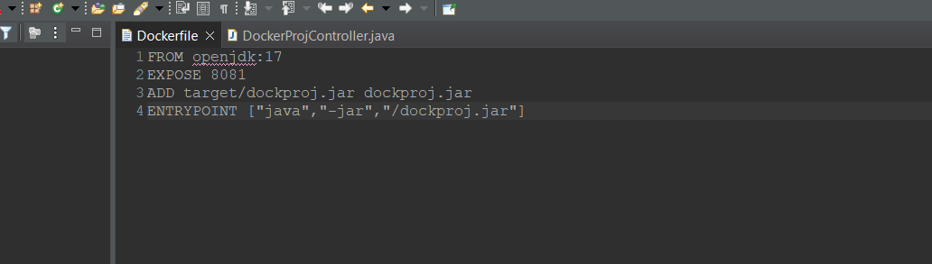
Creating Docker file, JAR File
Step 3: Create JAR file name under pom.xml file of project
Step 4: Create Docker file in Project with Following Code
Step 5: Generate JAR File by clicking Run as Maven Intall

Slide 15
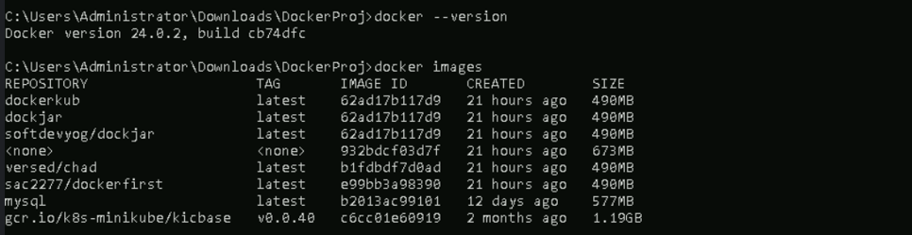
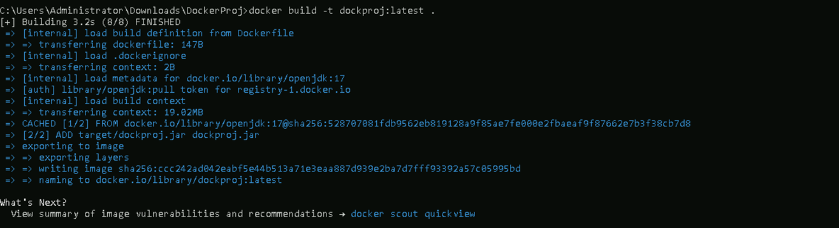
Dockerizing Project
Step 6: Creating Docker Image from JAR file

Slide 16
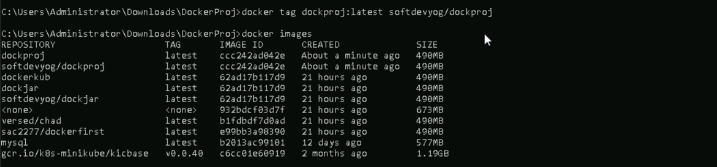
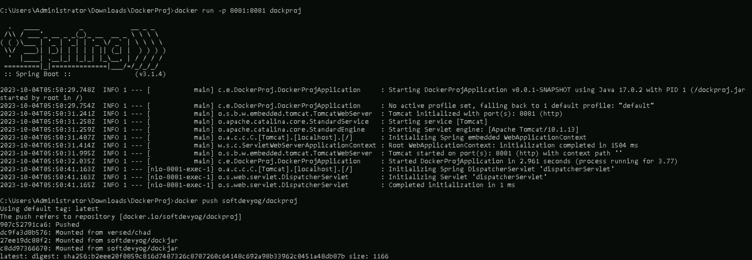
Dockerizing Project
Step 7: Creating Tag for Image, Executing Image and Pushing Image

Slide 17
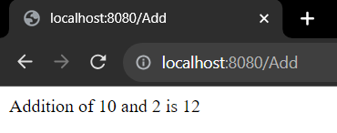
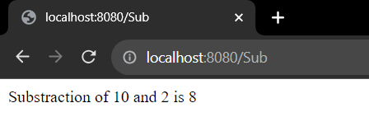
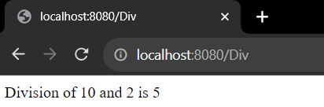
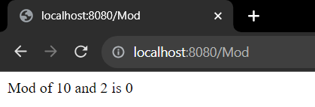
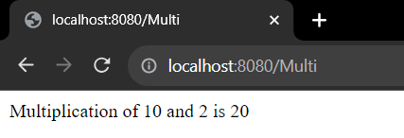
Outputs

Slide 18
THANK YOU

